Slide 2
Objectives
Describe an array
Explain declaration, initialization, and instantiation of a single-dimensional array
Explain declaration, initialization, and instantiation of a multi-dimensional array
Explain the use of loops to process an array
Describe ArrayList and accessing values from an ArrayList
Describe String and StringBuilder classes
Explain command line arguments
Describe Wrapper classes, autoboxing, and unboxing

Slide 3
Introduction
Consider a situation where in a user wants to store the marks of ten students.
For this purpose, the user can create ten different variables of type integer and store the marks in them.
What if the user wants to store marks of hundreds or thousands of students?
In such a case, one would need to create as many variables.
This can be a very difficult, tedious, and time consuming task.
Here, it is required to have a feature that will enable storing of all the marks in one location and access it with similar variable names.
Array, in Java, is a feature that allows storing multiple values of similar type in the same variable.

Slide 4
Introduction to Arrays 1-3
An array is a special data store that can hold a fixed number of values of a single type in contiguous memory locations.
It is implemented as objects.
The size of an array depends on the number of values it can store and is specified when the array is created.
After creation of an array, its size or length becomes fixed. Following figure shows an array of numbers:
The figure displays an array of ten integers storing values such as, 20, 100, 40, and so on.

Slide 5
Introduction to Arrays 2-3
Each value in the array is called an element of the array.
The numbers 0 to 9 indicate the index or subscript of the elements in the array.
The length or size of the array is 10. The first index begins with zero.
Since the index begins with zero, the index of the last element is always length - 1.
The last, that is, tenth element in the given array has an index value of 9.
Each element of the array can be accessed using the subscript or index.
Array can be created from primitive data types such as int, float, boolean as well as from reference type such as object.
The array elements are accessed using a single name but with different subscripts.
The values of an array are stored at contiguous locations in memory.
This induces less overhead on the system while searching for values.

Slide 6
Introduction to Arrays 3-3
The use of arrays has the following benefits:
Arrays are the best way of operating on multiple data elements of the same type at the same time.
Arrays make optimum use of memory resources as compared to variables.
Memory is assigned to an array only at the time when the array is actually used. Thus, the memory is not consumed by an array right from the time it is declared.
Arrays in Java are of the following two types:
Single-dimensional arrays
Multi-dimensional arrays

Slide 7
Declaring, Instantiating, and Initializing Single-dimensional Array 1-8
A single-dimensional array has only one dimension and is visually represented as having a single column with several rows of data.
Each element is accessed using the array name and the index at which the element is located.
Following figure shows the array named marks and its elements with their values and indices:
The size or length of the array is specified as 4 in square brackets ‘[]’.
marks[0] indicates the first element in the array.
marks[3], that is, marks[length-1] indicates the last element of the array.
Notice that there is no element with index 4.

Slide 8
Declaring, Instantiating, and Initializing Single-dimensional Array 2-8
An attempt to write marks[4] will issue an exception.
An exception is an abnormal event that occurs during the program execution and disrupts the normal flow of instructions.
Array creation involves the following tasks:
Declaring an Array
Declaring an array notifies the compiler that the variable will contain an array of the specified data type. It does not create an array.
The syntax for declaring a single-dimensional array is as follows:
Syntax
datatype[] <array-name>;
where,
datatype: Indicates the type of elements that will be stored in the array.
[]: Indicates that the variable is an array.
array-name: Indicates the name by which the elements of the array will be accessed.

Slide 9
Declaring, Instantiating, and Initializing Single-dimensional Array 3-8
For example,
int[] marks;
Similarly, arrays of other types can also be declared as follows:
byte[] byteArray;
float[] floatsArray;
boolean[] booleanArray;
char[] charArray;
String[] stringArray;
Instantiating an Array
Since array is an object, memory is allocated only when it is instantiated.
The syntax for instantiating an array is as follows:
Syntax
datatype[] <array-name> = new datatype[size];
where,
new: Allocates memory to the array.

Slide 10
Declaring, Instantiating, and Initializing Single-dimensional Array 4-8
size: Indicates the number of elements that can be stored in the array.
For example,
int[] marks = new int[4];
Initializing an Array
Since, array is an object that can store multiple values, array needs to be initialized with the values to be stored in it.
Array can be initialized in the following two ways:
During creation:
To initialize a single-dimensional array during creation, one must specify the values to be stored while creating the array as follows: int[ ] marks = {65, 47, 75, 50};
Notice that while initializing an array during creation, the new keyword or size is not required.
This is because all the elements to be stored have been specified and accordingly the memory gets automatically allocated based on the number of elements.

Slide 11
Declaring, Instantiating, and Initializing Single-dimensional Array 5-8
After creation:
A single-dimensional array can also be initialized after creation and instantiation.
In this case, individual elements of the array need to be initialized with appropriate values.
For example,
int[] marks = new int[4];
marks[0] = 65;
marks[1] = 47;
marks[2] = 75;
marks[3] = 50;
Notice that in this case, the array must be instantiated and size must be specified.
This is because, the actual values are specified later and to store the values, memory must be allocated during creation of the array.
Another way of creating an array is to split all the three stages as follows:
int marks[]; // declaration
marks = new int[4]; // instantiation
marks[0] = 65; // initialization

Slide 12
Declaring, Instantiating, and Initializing Single-dimensional Array 6-8
Following code snippet demonstrates an example of single-dimensional array:
package session8;
public class OneDimension {
//Declare a single-dimensional array named marks
int marks[]; // line 1
/**
* Instantiates and initializes a single-dimensional array
*
* @return void
*/
public void storeMarks() {
// Instantiate the array
marks = new int[4]; // line 2
System.out.println(“Storing Marks. Please wait...”);
// Initialize array elements
marks[0] = 65; // line 3
marks[1] = 47;
marks[2] = 75;
marks[3] = 50;
}

Slide 13
Declaring, Instantiating, and Initializing Single-dimensional Array 7-8
/**
* Displays marks from a single-dimensional array
*
* @return void
*/
public void displayMarks() {
System.out.println(“Marks are:”);
// Display the marks
System.out.println(marks[0]);
System.out.println(marks[1]);
System.out.println(marks[2]);
System.out.println(marks[3]);
}
/**
* @param args the command line arguments
*/
public static void main(String[] args) {
//Instantiate class OneDimension
OneDimension oneDimenObj = new OneDimension(); //line 4

Slide 14
Declaring, Instantiating, and Initializing Single-dimensional Array 8-8
//Invoke the storeMarks() method
oneDimenObj.storeMarks(); // line 5
//Invoke the displayMarks() method
oneDimenObj.displayMarks(); // line 6
}
}
The class OneDimension consists of an array named marks[] declared in line 1.
To instantiate and initialize the array elements, the method storeMarks() is created.
To display the array elements, the displayMarks() method is created.
Following figure shows the output of the code:

Slide 15
Declaring, Instantiating, and Initializing Multi-dimensional Array 1-7
A multi-dimensional array in Java is an array whose elements are also arrays. This allows the rows to vary in length.
The syntax for declaring and instantiating a multi-dimensional array is as follows:
Syntax
datatype[][] <array-name> = new datatype [rowsize][colsize];
where,
datatype: Indicates the type of elements that will be stored in the array.
rowsize and colsize: Indicates the number of rows and columns that the array will contain.
new: Keyword used to allocate memory to the array elements.
For example,
int[][] marks = new int[4][2];
The array named marks consists of four rows and two columns.

Slide 16
Declaring, Instantiating, and Initializing Multi-dimensional Array 2-7
A multi-dimensional array can be initialized in the following two ways:
During creation
To initialize a multi-dimensional array during creation, one must specify the values to be stored while creating the array as follows:
int[][] marks = {{23,65}, {42,47}, {60,75}, {75,50}};
While initializing an array during creation, the elements in rows are specified in a set of curly brackets separated by a comma delimiter.
Also, the individual rows are separated by a comma separator.
This is a two-dimensional array that can be represented in a tabular form as shown in the following figure:

Slide 17
Declaring, Instantiating, and Initializing Multi-dimensional Array 3-7
After creation
A multi-dimensional array can also be initialized after creation and instantiation.
In this case, individual elements of the array need to be initialized with appropriate values.
Each element is accessed with a row and column subscript.
For example,
int[][] marks = new int[4][2];
marks[0][0] = 23; // first row, first column
marks[0][1] = 65; // first row, second column
marks[1][0] = 42;
marks[1][1] = 47;
marks[2][0] = 60;
marks[2][1] = 75;
marks[3][0] = 75;
marks[3][1] = 50;

Slide 18
Declaring, Instantiating, and Initializing Multi-dimensional Array 4-7
The element 23 is said to be at position (0,0), that is, first row and first column.
Therefore, to store or access the value 23, one must use the syntax marks[0][0].
Similarly, for other values, the appropriate row-column combination must be used.
Similar to row index, column index also starts at zero. Therefore, in the given scenario, an attempt to write marks[0][2] would result in an exception as the column size is 2 and column indices are 0 and 1.
Following code snippet demonstrates an example of two-dimensional array:
package session8;
public class TwoDimension {
//Declare a two-dimensional array named marks
int marks[][]; //line 1
/**
* Stores marks in a two-dimensional array
*
* @return void
*/
public void storeMarks() {

Slide 19
Declaring, Instantiating, and Initializing Multi-dimensional Array 5-7
// Instantiate the array
marks = new int[4][2]; // line 2
System.out.println(“Storing Marks. Please wait...”);
// Initialize array elements
marks[0][0] = 23; // line 3
marks[0][1] = 65;
marks[1][0] = 42;
marks[1][1] = 47;
marks[2][0] = 60;
marks[2][1] = 75;
marks[3][0] = 75;
marks[3][1] = 50;
}
/**
* Displays marks from a two-dimensional array
*
* @return void
*/
public void displayMarks() {

Slide 20
Declaring, Instantiating, and Initializing Multi-dimensional Array 6-7
/**
* Displays marks from a two-dimensional array
*
* @return void
*/
public void displayMarks() {
System.out.println(“Marks are:”); // Display the marks
System.out.println(“Roll no.1:” + marks[0][0]+ “,” + marks[0][1]);
System.out.println(“Roll no.2:” + marks[1][0]+ “,” + marks[1][1]);
System.out.println(“Roll no.3:” + marks[2][0]+ “,” + marks[2][1]);
System.out.println(“Roll no.4:” + marks[3][0]+ “,” + marks[3][1]);
}
/**
* @param args the command line arguments
*/
public static void main(String[] args) {
//Instantiate class TwoDimension
TwoDimension twoDimenObj = new TwoDimension(); // line 4

Slide 21
Declaring, Instantiating, and Initializing Multi-dimensional Array 7-7
//Invoke the storeMarks() method
twoDimenObj.storeMarks();
//Invoke the displayMarks() method
twoDimenObj.displayMarks();
}
}
Following figure shows the output of the code, that is, marks of four students are displayed from the array marks[][]:

Slide 22
Using Loops to Process and Initialize an Array 1-6
A user can use loops to process and initialize an array.
Following code snippet depicts the revised displayMarks() method of the single-dimensional array named marks[]:
...
public void displayMarks() {
System.out.println(“Marks are:”);
// Display the marks using for loop
for(int count = 0; count < marks.length; count++) {
System.out.println(marks[count]);
}
}
...
In the code, a for loop has been used to iterate the array from zero to marks.length.
The property, length, of the array object is used to obtain the size of the array.
Within the loop, each element is displayed by using the element name and the variable count, that is, marks[count].

Slide 23
Using Loops to Process and Initialize an Array 2-6
Following code snippet depicts the revised displayMarks() method of the two-dimensional array marks[][]:
...
public void displayMarks(){
System.out.println(“Marks are:”);
// Display the marks using nested for loop
// outer loop
for (int row = 0; row < marks.length; row++) {
System.out.println(“Roll no.” + (row+1));
// inner loop
for (int col = 0; col < marks[row].length; col++) {
System.out.println(marks[row][col]);
}
}
}
...

Slide 24
Using Loops to Process and Initialize an Array 3-6
The outer loop keeps track of the number of rows and inner loop keeps track of the number of columns in each row.
Following figure shows the output of the two-dimensional array marks[][], after using the for loop:

Slide 25
Using Loops to Process and Initialize an Array 4-6
One can also use the enhanced for loop to iterate through an array.
Following code snippet depicts the modified displayMarks() method of single-dimensional array marks[] using the enhanced for loop:
...
public void displayMarks() {
System.out.println(“Marks are:”);
// Display the marks using enhanced for loop
for(int value:marks) {
System.out.println(value);
}
}
...
The loop will print all the values of marks[] array till marks.length without having to explicitly specify the initializing and terminating conditions for iterating through the loop.

Slide 26
Using Loops to Process and Initialize an Array 5-6
Following code snippet demonstrates the calculation of total marks of each student by using the for loop and the enhanced for loop together with the two-dimensional array marks[][]:
...
public void totalMarks() {
System.out.println(“Total Marks are:”);
// Display the marks using for loop and enhanced for loop
for (int row = 0; row < marks.length; row++) {
System.out.println(“Roll no.” + (row+1));
int sum = 0;
// enhanced for loop
for(int value:marks[row]) {
sum = sum + value;
}
System.out.println(sum);
}
}
...

Slide 27
Using Loops to Process and Initialize an Array 6-6
The enhanced for loop is used to iterate through the columns of the row selected in the outer loop using marks[row].
The code sum = sum + value will add up the values of all columns of the currently selected row.
The selected row is indicated by the subscript variable row.
Following figure shows the sum of the values of the two-dimensional array named marks[][] using for loop and enhanced for loop together:

Slide 28
Initializing an ArrayList 1-8
One major disadvantage of an array is that its size is fixed during creation. The size cannot be modified later.
To resolve this issue, it is required to have a construct to which memory can be allocated based on requirement.
Also, addition and deletion of values can be performed easily. Java provides the concept of collections to address this problem.
A collection is a single object that groups multiple elements into a single unit.
The core Collection interfaces that encapsulate different types of collections are shown in the following figure:

Slide 29
Initializing an ArrayList 2-8
The general-purpose implementations are summarized in the following table:
Interfaces | Hash table | Resizable array | Tree | Linked list | Hash table + Linked list
Set | HashSet | - | TreeSet | - | LinkedHashSet
List | - | ArrayList | - | LinkedList | -
Queue | - | - | - | - | -
Map | HashMap | - | TreeMap | - | LinkedHashMap
The ArrayList class is a frequently used collection that has the following characteristics:
It is flexible and can be increased or decreased in size as needed.
Provides several useful methods to manipulate the collection.
Insertion and deletion of data is simpler.
It can be traversed by using for loop, enhanced for loop, or other iterators.

Slide 30
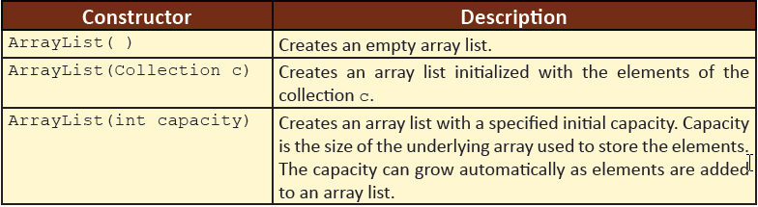
Initializing an ArrayList 3-8
ArrayList extends AbstractList and implements the interfaces such as List, Cloneable, and Serializable.
The capacity of an ArrayList grows automatically.
It stores all elements including null.
The Arraylist collection provides methods to manipulate the size of the array.
Following table lists the constructors of ArrayList class:

Slide 31
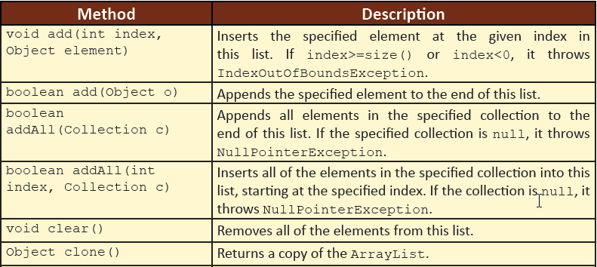
Initializing an ArrayList 4-8
ArrayList consists of several methods for adding elements.
These methods can be broadly divided into following two categories:
Methods that append one or more elements to the end of the list.
Methods that insert one or more elements at a position within the list.
Following table lists the methods of ArrayList class:

Slide 32
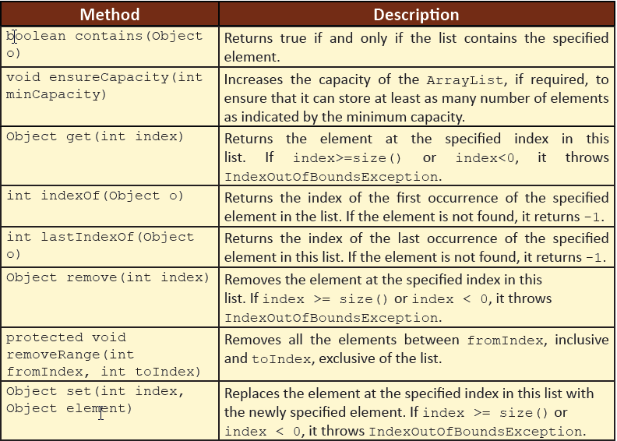
Initializing an ArrayList 5-8

Slide 33
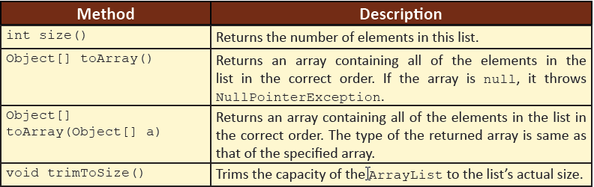
Initializing an ArrayList 6-8
To traverse an ArrayList, one can use one of the following approaches:
A for loop
An enhanced for loop
Iterator
ListIterator

Slide 34
Initializing an ArrayList 7-8
Iterator interface provides methods for traversing a set of data.
It can be used with arrays as well as various classes of the Collection framework.
The Iterator interface provides the following methods for traversing a collection:
next()
This method returns the next element of the collection.
hasNext()
This method returns true if there are additional elements in the collection.
remove()
This method removes the element from the list while iterating through the collection.
There are no specific methods in the ArrayList class for sorting.
However, one can use the sort() method of the Collections class to sort an ArrayList.

Slide 35
Initializing an ArrayList 8-8
The syntax for using the sort() method is as follows:
Syntax
Collections.sort(<list-name>);
Following code snippet demonstrates instantiation and initialization of an ArrayList:
ArrayList marks = new ArrayList(); // Instantiate an ArrayList
marks.add(67); // Initialize an ArrayList
marks.add(50);

Slide 36
Accessing Values in an ArrayList 1-5
An ArrayList can be iterated by using the for loop or by using the Iterator interface.
Following code snippet demonstrates the use of ArrayList named marks to add and display marks of students:
package session8;
import java.util.ArrayList;
import java.util.Collections;
import java.util.Iterator;
public class ArrayLists{
// Create an ArrayList instance
ArrayList marks = new ArrayList(); // line 1
/**
* Stores marks in ArrayList
*
* @return void
*/
public void storeMarks(){
System.out.println(“Storing marks. Please wait...”);
marks.add(67); // line 2

Slide 37
Accessing Values in an ArrayList 2-5
marks.add(50);
marks.add(45);
marks.add(75);
}
/**
* Displays marks from ArrayList
*
* @return void
*/
public void displayMarks() {
System.out.println(“Marks are:”);
// iterating the list using for loop
System.out.println(“Iterating ArrayList using for loop:”);
for (int i = 0; i < marks.size(); i++) {
System.out.println(marks.get(i));
}
System.out.println(“-------------------------------------”);

Slide 38
Accessing Values in an ArrayList 3-5
// Iterate the list using Iterator interface
Iterator imarks = marks.iterator(); // line 3
System.out.println(“Iterating ArrayList using Iterator:”);
while (imarks.hasNext()) { // line 4
System.out.println(imarks.next()); // line 5
}
System.out.println(“-------------------------------------”);
// Sort the list
Collections.sort(marks); // line 6
System.out.println(“Sorted list is: “ + marks);
}
/**
* @param args the command line arguments
*/
public static void main(String[] args) {
//Instantiate the class OneDimension
ArrayLists obj = new ArrayLists(); // line 7

Slide 39
Accessing Values in an ArrayList 4-5
//Invoke the storeMarks() method
obj.storeMarks();
//Invoke the displayMarks() method
obj.displayMarks();
}
}
The Iterator object imarks is instantiated in line 3 and attached with the marks ArrayList using marks.iterator().
It is used to iterate through the collection.
The Iterator interface provides the hasNext() method to check if there are any more elements in the collection as shown in line 4.
The method, next() is used to traverse to the next element in the collection.
The retrieved element is then displayed to the user in line 5.
The static method, sort() of Collections class is used to sort the ArrayList marks in line 6 and print the values on the screen.

Slide 40
Accessing Values in an ArrayList 5-5
Following figure shows the output of the code:
The values of an ArrayList can also be printed by simply writing System.out.println(“Marks are:”+ marks).
In this case, the output would be: Marks are:[67, 50, 45, 75].

Slide 41
Introduction to Strings
Consider a scenario, where in a user wants to store the name of a person.
One can create a character array as shown in the following code snippet:
char[] name = {‘J’,’u’,’l’,’i’,’a’}
Similarly, to store names of multiple persons, one can create a two-dimensional array.
However, the number of characters in an array must be fixed during creation.
This is not possible since the names of persons may be of variable sizes.
Also, manipulating the character array would be tedious and time consuming.
Java provides the String data type to store multiple characters without creating an array.

Slide 42
Strings 1-3
String literals such as “Hello” in Java are implemented as instances of the String class.
Strings are constant and immutable, that is, their values cannot be changed once they are created.
String buffers allow creation of mutable strings.
A simple String instance can be created by enclosing a string literal inside double quotes as shown in the following code snippet:
...
String name = “Mary”;
// This is equivalent to:
char name[] = {‘M’, ‘a’, ‘r’, ’y’};
...
An instance of a String class can also be created using the new keyword, as shown in code snippet:
String str = new String();
The code creates a new object of class String, and assigns its reference to the variable str.

Slide 43
Strings 2-3
Java also provides special support for concatenation of strings using the plus (+) operator and for converting data of other types to strings as depicted in the following code snippet:
...
String str = “Hello”; String str1 = “World”;
// The two strings can be concatenated by using the operator ‘+’
System.out.println(str + str1);
// This will print ‘HelloWorld’ on the screen
...
One can convert a character array to a string as depicted in the following code snippet:
char[] name = {‘J’, ‘o’, ‘h’, ‘n’}; String empName = new String(name);
The java.lang.String class is a final class, that is, no class can extend it.
The java.lang.String class differs from other classes, in that one can use ‘+=’ and ‘+’ operators with String objects for concatenation.

Slide 44
Strings 3-3
If the string is not likely to change later, one can use the String class.
Thus, a String class can be used for the following reasons:
String is immutable and so it can be safely shared between multiple threads.
The threads will only read them, which is normally a thread safe operation.
If the string is likely to change later and it will be shared between multiple threads, one can use the StringBuffer class.
The use of StringBuffer class ensures that the string is updated correctly.
However, the drawback is that the method execution is comparatively slower.
If the string is likely to change later but will not be shared between multiple threads, one can use the StringBuilder class.
The StringBuilder class can be used for the following reasons:
It allows modification of the strings without the overhead of synchronization.
Methods of StringBuilder class execute as fast as, or faster, than those of the StringBuffer class

Slide 45
Working with String Class 1-7
Some of the frequently used methods of String class are as follows:
length(String str)
charAt(int index)
The length() method is used to find the length of a string. For example,
The charAt() method is used to retrieve the character value at a specific index.
concat(String str)
The concat() method is used to concatenate a string specified as argument to the end of another string.
String str = ”Hello”;
System.out.println(str.length()); // output: 5
The index ranges from zero to length() – 1.
The index of the first character starts at zero. For example,
System.out.println(str.charAt(2)); // output: ‘l’
If the length of the string is zero, the original String object is returned, otherwise a new String object is returned.
System.out.println(str.concat(”World”)); // output: ‘HelloWorld’

Slide 46
Working with String Class 2-7
compareTo(String str)
The compareTo() method is used to compare two String objects.
The comparison returns an integer value as the result.
The comparison is based on the Unicode value of each character in the strings.
The result will return a negative value, if the argument string is alphabetically greater than the original string.
The result will return a positive value, if argument string is alphabetically lesser than the original string and the result will return a value of zero, if both the strings are equal.
For example,
System.out.println(str.compareTo(“World”)); // output: -15
The output is 15 because, the second string “World” begins with ‘W’ which is alphabetically greater than the first character ‘H’ of the original string, str.
The difference between the position of ‘H’ and ‘W’ is 15.
Since ‘H’ is smaller than ‘W’, the result will be -15.
indexOf(String str)
The indexOf() method returns the index of the first occurrence of the specified character or string within a string.
If the character or string is not found, the method returns -1. For example,
System.out.println(str.indexOf(“e”)); // output: 1

Slide 47
Working with String Class 3-7
lastIndexOf(String str)
replace(char old, char new)
The lastIndexOf() method returns the index of the last occurrence of a specified character or string from within a string.
The replace() method is used to replace all the occurrences of a specified character in the current string with a given new character.
System.out.println(str.lastIndexOf(“l”)); // output: 3
The specified character or string is searched backwards that is the search begins from the last character. For example,
System.out.println(str.replace(‘e’,’a’)); // output: ‘Hallo’
If the specified character does not exist, the reference of original string is returned. For example,
The substring() method is used to retrieve a part of a string, that is, substring from the given string.
substring(int beginIndex, int endIndex)
System.out.println(str.substring(2,5)); // output: ‘llo’
If end index is not specified, all characters from the start index to the end of the string will be returned. For example,
One can specify the start index and the end index for the substring.

Slide 48
Working with String Class 4-7
toString()
The toString() method is used to return a String object.
trim()
The trim() method returns a new string by trimming the leading and trailing whitespace from the current string. For example,
Integer length = 5;
System.out.println(length.toString()); // output: 5
Notice that the output is still 5. However, now it is represented as a string instead of an integer.
It is used to convert values of other data types into strings. For example,
String str1 = ” Hello “;
System.out.println(str1.trim()); // output: ‘Hello’
The trim() method will return ‘Hello’ after removing the spaces.

Slide 49
Working with String Class 5-7
Following code snippet demonstrates the use of String class methods:
public class Strings {
String str = “Hello”; // Initialize a String variable
Integer strLength = 5; // Use the Integer wrapper class
/**
* Displays strings using various String class methods
*
* @return void
*/
public void displayStrings(){
// using various String class methods
System.out.println(“String length is:”+ str.length());
System.out.println(“Character at index 2 is:”+ str.charAt(2));
System.out.println(“Concatenated string is:”+ str.concat(“World”));
System.out.println(“String comparison is:”+ str.compareTo(“World”));
System.out.println(“Index of o is:”+ str.indexOf(“o”));
System.out.println(“Last index of l is:”+ str.lastIndexOf(“l”));
System.out.println(“Replaced string is:”+ str.replace(‘e’,’a’));
System.out.println(“Substring is:”+ str.substring(2, 5));

Slide 50
Working with String Class 6-7
System.out.println(“Integer to String is:”+ strLength.toString()) ;
String str1=” Hello “;
System.out.println(“Untrimmed string is:”+ str1);
System.out.println(“Trimmed string is:”+ str1.trim());
}
/**
* @param args the command line arguments
*/
public static void main(String[] args) {
//Instantiate class, Strings
Strings objString = new Strings(); // line 1
//Invoke the displayStrings() method
objString.displayStrings();
}
}

Slide 51
Working with String Class 7-7
Following figure shows the output of the Strings.java class:

Slide 52
Working with StringBuilder Class 1-2
StringBuilder objects are similar to String objects, except that they are mutable and flexible.
Internally, the system treats these objects as a variable-length array containing a sequence of characters.
The length and content of the sequence of characters can be changed through methods available in the StringBuilder class.
For concatenating a large number of strings, using a StringBuilder object is more efficient.
The StringBuilder class also provides a length() method that returns the length of the character sequence in the class.
Unlike strings a StringBuilder object also has a property capacity that specifies the number of character spaces that have been allocated.
The capacity is returned by the capacity() method and is always greater than or equal to the length.
The capacity will automatically expand to accommodate the new strings when added to the string builder.
StringBuilder object allows insertion of characters and strings as well as appending characters and strings at the end.

Slide 53
Working with StringBuilder Class 2-2
The constructors of the StringBuilder class are as follows:
StringBuilder()
Default constructor that provides space for 16 characters.
StringBuilder(int capacity)
Constructs an object without any characters in it.
StringBuilder
(String str)
Constructs an object that is initialized with the contents of the specified string, str.
However, it reserves space for the number of characters specified in the argument, capacity.

Slide 54
Methods of StringBuilder Class 1-5
The StringBuilder class provides several methods for appending, inserting, deleting, and reversing strings as follows:
append()
The append() method is used to append values at the end of the StringBuilder object.
For each append() method, String.valueOf() method is invoked to convert the parameter into a corresponding string representation value and then the new string is appended to the StringBuilder object.
For example,
StringBuilder str = new StringBuilder(“JAVA ”);
System.out.println(str.append(“SE ”); // output: JAVA SE
System.out.println(str.append(7); // output: JAVA SE 7
This method accepts different types of arguments, including char, int, float, double, boolean, and so on, but the most common argument is of type String.

Slide 55
Methods of StringBuilder Class 2-5
insert()
The insert() method is used to insert one string into another.
StringBuilder insert(int insertPosition, String str)
StringBuilder insert(int insertPosition, char ch)
StringBuilder insert(int insertPosition, float f)
For example,
StringBuilder str = new StringBuilder(“JAVA 7 ”);
System.out.println(str.insert(5, “SE”); // output: JAVA SE 7
It calls the String.valueOf() method to obtain the string representation of the value.
The new string is inserted into the invoking StringBuilder object.
The insert() method has several versions as follows:

Slide 56
Methods of StringBuilder Class 3-5
delete()
The delete() method deletes the specified number of characters from the invoking StringBuilder object.
reverse()
The reverse() method is used to reverse the characters within a StringBuilder object.
For example,
StringBuilder str = new StringBuilder(“JAVA SE 7”);
System.out.println(str.delete(4,7); // output: JAVA 7
StringBuilder str = new StringBuilder(“JAVA SE 7”);
System.out.println(str.reverse()); // output: 7 ES AVAJ
For example,

Slide 57
Methods of StringBuilder Class 4-5
Following code snippet demonstrates the use of methods of the StringBuilder class:
package session8;
public class StringBuilders {
// Instantiate a StringBuilder object
StringBuilder str = new StringBuilder(“JAVA “);
/**
* Displays strings using various StringBuilder methods
*
* @return void
*/
public void displayStrings(){
// Use the various methods of the StringBuilder class
System.out.println(“Appended String is “+ str.append(“7”));
System.out.println(“Inserted String is “+ str.insert(5, “SE “));
System.out.println(“Deleted String is “+ str.delete(4,7));
System.out.println(“Reverse String is “+ str.reverse());
}

Slide 58
Methods of StringBuilder Class 5-5
/**
* @param args the command line arguments
*/
public static void main(String[] args) {
//Instantiate the StringBuilders class
StringBuilders objStrBuild = new StringBuilders(); // line 1
//Invoke the displayStrings() method
objStrBuild.displayStrings();
}
}
Following figure shows the output of the StringBuilders.java class:

Slide 59
String Arrays 1-3
Sometimes there is a need to store a collection of strings.
String arrays can be created in Java in the same manner as arrays of primitive data types.
For example, String[] empNames = new String[10];
This statement will allocate memory to store references of 10 strings.
However, no memory is allocated to store the characters that make up the individual strings.
Loops can be used to initialize as well as display the values of a String array.
Following code snippet demonstrates the creation of a String array:
package session8;
public class StringArray {
// Instantiate a String array
String[] empID = new String[5];

Slide 60
String Arrays 2-3
/**
* Creates a String array
* @return void
*/
public void createArray() {
System.out.println(“Creating Array. Please wait...”);
// Use a for loop to initialize the array
for(int count = 1; count < empID.length; count++){
empID[count]= “E00”+count; // storing values in the array
}
}
/**
* Displays the elements of a String array
* @return void
*/
public void printArray() {
System.out.println(“The Array is:”);
// Use a for loop to print the array
for(int count = 1; count < empID.length; count++){
System.out.println(“Employee ID is: “+ empID[count]);
}
}

Slide 61
String Arrays 3-3
/**
* @param args the command line arguments
*/
public static void main(String[] args) {
//Instantiate class Strings
StringArray objStrArray = new StringArray(); // line 1
//Invoke createArray() method
objStrArray.createArray();
//Invoke printArray() method
objStrArray.printArray();
}
}
Following figure shows the output of the StringArray.java class:

Slide 62
Command Line Arguments 1-7
A user can pass any number of arguments to a Java application at runtime from the OS command line.
The main() method declares a parameter named args[] which is a String array that accepts arguments from the command line.
These arguments are placed on the command line and follow the class name when it is executed.
For example,
java EmployeeDetail Roger Smith Manager
Here, EmployeeDetail is the name of a class.
Roger, Smith, and Manager are command line arguments which are stored in the array in the order that they are specified.
When the application is launched, the runtime system passes the command line arguments to the application’s main() method using a String array, args[].
The array of strings can be given any other name.
The args[] array accepts the arguments and stores them at appropriate locations in the array.

Slide 63
Command Line Arguments 2-7
The length of the array is determined from the number of arguments passed at runtime.
The arguments are separated by a space.
The basic purpose of command line arguments is to specify the configuration information for the application.
The main() method is the entry point of a Java program, where objects are created and methods are invoked.
The static main() method accepts a String array as an argument as depicted in the following code snippet:
public static void main(String[] args) {}
The parameter of the main() method is a String array that represents the command line arguments.
The size of the array is set to the number of arguments specified at runtime.
All command line arguments are passed as strings.

Slide 64
Command Line Arguments 3-7
Following code snippet demonstrates an example of command line arguments:
package session8;
public class CommandLine {
/**
* @param args the command line arguments
*/
public static void main(String[] args) {
// Check the number of command line arguments
if(args.length==3) {
// Display the values of individual arguments
System.out.println(“First Name is “+args[0]);
System.out.println(“Last Name is “+args[1]);
System.out.println(“Designation is “+args[2]);
}
else {
System.out.println(“Specify the First Name, Last Name, and
Designation”);
}
}
}

Slide 65
Command Line Arguments 4-7
To run the program with command line arguments at command prompt, do the following:
1
Open the command prompt.
2
Compile the Java program by writing the following statement:
3
Execute the program by writing the following statement:
javac CommandLine.java
java CommandLine Roger Smith Manager
To run the program with command line arguments using NetBeans IDE, perform the following steps:
1
Right-click the project name in the Projects tab and click Properties.
2
Click Run in the Categories pane to the left.
The Project Properties dialog box is displayed.
The runtime properties are displayed in the right pane.

Slide 66
Command Line Arguments 5-7
The runtime properties are shown in the following figure:

Slide 67
Command Line Arguments 6-7
3
Type the arguments Roger, Smith, and Manager in the Arguments box as shown in the following figure:

Slide 68
Command Line Arguments 7-7
4
Click OK to close the Project Properties dialog box.
5
Click Run on the toolbar or press F6.
The command line arguments are supplied to the main() method and printed as shown in the following figure:

Slide 69
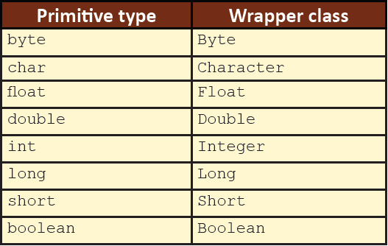
Wrapper Classes 1-11
Java provides a set of classes known as wrapper classes for each of its primitive data type that ‘wraps’ the primitive type into an object of that class.
In other words, the wrapper classes allow accessing primitive data types as objects.
The wrapper classes for the primitive data types are: Byte, Character, Integer, Long, Short, Float, Double, and Boolean.
The wrapper classes are part of the java.lang package.
The primitive types and the corresponding wrapper types are listed in the following table:

Slide 70
Wrapper Classes 2-11
What is the need for wrapper classes?
The use of primitive types as objects can simplify tasks at times.
For example, most of the collections store objects and not primitive data types.
Many of the activities reserved for objects will not be available to primitive data types.
Also, many utility methods are provided by the wrapper classes that help to manipulate data.
Wrapper classes convert primitive data types to objects, so that they can be stored in any type of collection and also passed as parameters to methods.
Wrapper classes can convert numeric strings to numeric values.

Slide 71
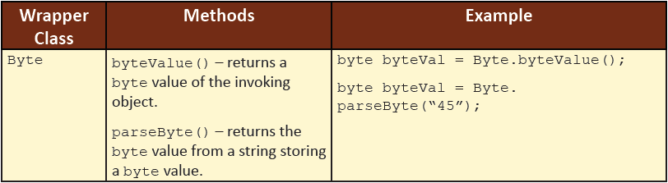
Wrapper Classes 3-11
valueOf()
The valueOf() method is available with all the wrapper classes to convert a type into another type.
typeValue()
The typeValue() method can also be used to return the value of an object as its primitive type.
The valueOf() method of the Character class accepts only char as an argument.
The valueOf() method of any other wrapper class accepts either the corresponding primitive type or String as an argument.
Some of the wrapper classes and their methods are listed in the following table:

Slide 72
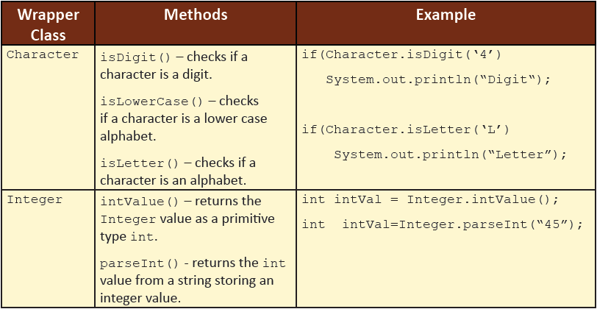
Wrapper Classes 4-11

Slide 73
Wrapper Classes 5-11
The difference between creation of a primitive type and a wrapper type is as follows:
Primitive type
int x = 10;
Wrapper type
Integer y = new Integer(20);
The first statement declares and initializes the int variable x to 10.
The second statement instantiates an Integer object y and initializes it with the value 20.
In this case, the reference of the object is assigned to the object variable y.
The memory assignment for the two statements is shown in the following figure:
It is clear from the figure that x is a variable that holds a value whereas y is an object variable that holds a reference to an object.

Slide 74
Wrapper Classes 6-11
The six methods of type parseXxx() available for each numeric wrapper type are in close relation to the valueOf() methods of all the numeric wrapper classes including Boolean.
The two type of methods, that is, parseXxx() and valueOf(), take a String as an argument.
If the String argument is not properly formed, both the methods throw a NumberFormatException.
These methods can convert String objects of different bases if the underlying primitive type is any of the four integer types.
The parseXxx() method returns a named primitive whereas the valueOf() method returns a new wrapped object of the type that invoked the method.

Slide 75
Wrapper Classes 7-11
Following code snippet demonstrates the use of Integer wrapper class to convert the numbers passed by user as strings at command line into integer types to perform the calculation based on the selected operation:
package session8;
public class Wrappers {
/**
* Performs calculation based on user input
*
* @return void
*/
public void calcResult(int num1, int num2, String choice){
// Switch case to evaluate the choice
switch(choice) {
case “+”: System.out.println(“Result after addition is: “+
(num1+num2));
break;
case “-”: System.out.println(“Result after subtraction is: “+
(num1-num2));
break;
case “*”: System.out.println(“Result after multiplication is: “+
(num1*num2));
break;

Slide 76
Wrapper Classes 8-11
case “/”: System.out.println(“Result after division is: “ +
(num1/num2));
break;
}
}
/**
* @param args the command line arguments
*/
public static void main(String[] args) {
// Check the number of command line arguments
if(args.length==3){
// Use the Integer wrapper to convert String argument to int type
int num1 = Integer.parseInt(args[0]);
int num2 = Integer.parseInt(args[1]);
// Instantiate the Wrappers class
Wrappers objWrap = new Wrappers();

Slide 77
Wrapper Classes 9-11
// Invoke the calcResult() method
objWrap.calcResult(num1, num2, args[2]);
}
else{
System.out.println(“Usage: num1 num2 operator”);
}
}
}
The class Wrappers consists of the calcResult() method that accepts two numbers and an operator as the parameter.
The main() method is used to convert the String arguments to int type by using the Integer wrapper class.
Next, the object, objWrap of Wrappers class is created to invoke the calcResult() method with three arguments namely, num1, num2, and args[2] which is the operator specified by the user as the third argument.

Slide 78
Wrapper Classes 10-11
To run the class, specify the command line values as 35, 48, and - in the Arguments box as shown in the following figure:

Slide 79
Wrapper Classes 11-11
When the program is executed, the first two arguments are stored in the args[0] and args[1] elements and then, converted to integers.
The third argument is stored in the args[2] element.
It is the operator to be applied on the numbers.
The output of the code is shown in the following figure:

Slide 80
Autoboxing and Unboxing 1-3
Autoboxing
The automatic conversion of primitive data types such as int, float, and so on to their corresponding object types such as Integer, Float, and so on during assignments and invocation of methods and constructors is known as autoboxing.
For example,
ArrayList<Integer> intList = new ArrayList<Integer>();
intList.add(10); // autoboxing
Integer y = 20; // autoboxing
Unboxing
The automatic conversion of object types to primitive data types is known as unboxing.
For example,
int z = y; // unboxing
Autoboxing and unboxing helps a developer to write a cleaner code.
Using autoboxing and unboxing, one can make use of the methods of wrapper classes as and when required.

Slide 81
Autoboxing and Unboxing 2-3
Following code snippet demonstrates an example of autoboxing and unboxing:
package session8;
public class AutoUnbox {
/**
* @param args the command line arguments
*/
public static void main(String args[]) {
Character chBox = ‘A’; // Autoboxing a character
char chUnbox = chBox; // Unboxing a character
// Print the values
System.out.println(“Character after autoboxing is:”+ chBox) ;
System.out.println(“Character after unboxing is:” + chUnbox);
}
}
The class AutoUnbox consists of two variable declarations chBox and chUnbox.
chBox is an object type and chUnbox is a primitive type of character variable.

Slide 82
Autoboxing and Unboxing 3-3
Following figure shows the output of the code:
The figure shows that both primitive as well as object type variable give the same output.
However, the variable of type object, that is chBox, can take advantage of the methods available with the wrapper class Character which are not available with the primitive type char.

Slide 83
Summary
An array is a special data store that can hold a fixed number of values of a single type in contiguous memory locations.
A single-dimensional array has only one dimension and is visually represented as having a single column with several rows of data.
A multi-dimensional array in Java is an array whose elements are also arrays.
A collection is an object that groups multiple elements into a single unit.
Strings are constant and immutable, that is, their values cannot be changed once they are created.
StringBuilder objects are similar to String objects, except that they are mutable.
Java provides a set of classes known as Wrapper classes for each of its primitive data type that ‘wrap’ the primitive type into an object of that class.
The automatic conversion of primitive types to object types is known as autoboxing and conversion of object types to primitive types is known as unboxing.

